Slide 1








ReNew
MOBILE COMPANY
UNLOCKING VALUE
REVOLUTIONIZING THE PRE-OWNED MOBILE MARKET THROUGH DATA-DRIVEN DECISION MAKING

Slide 2


GOALS
The primary goal of ReNew is to maximize profitability, accomplished through two key strategies:
Improve operational efficiency by accelerating inventory turnover in turn boosting profitability.
Offering competitive pricing for affordable yet reliable refurbished mobile devices, further enhancing profitability.

Slide 3

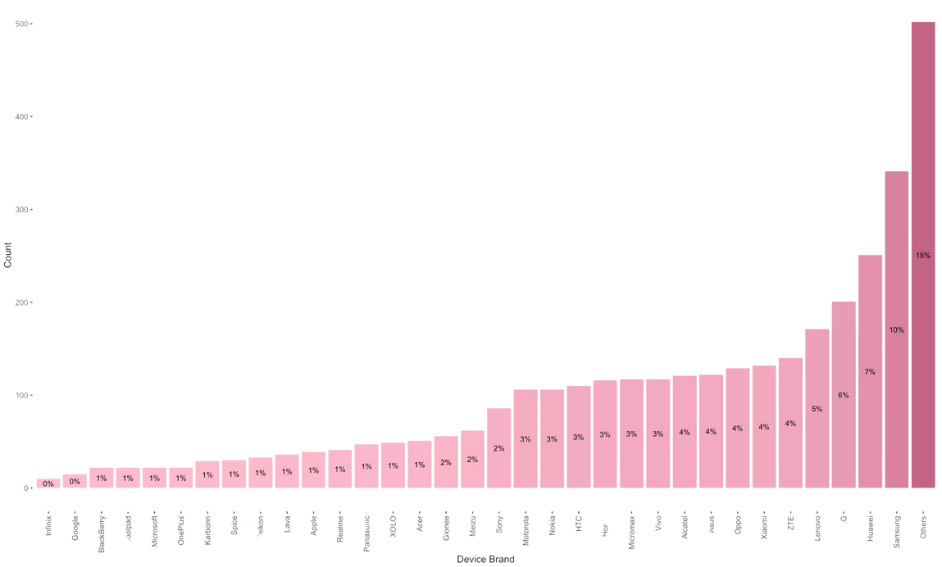
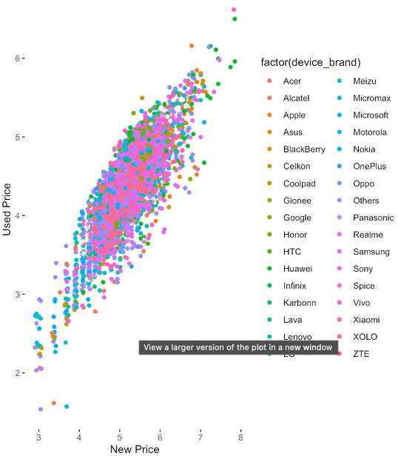
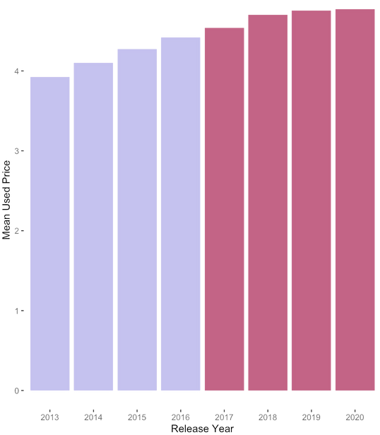
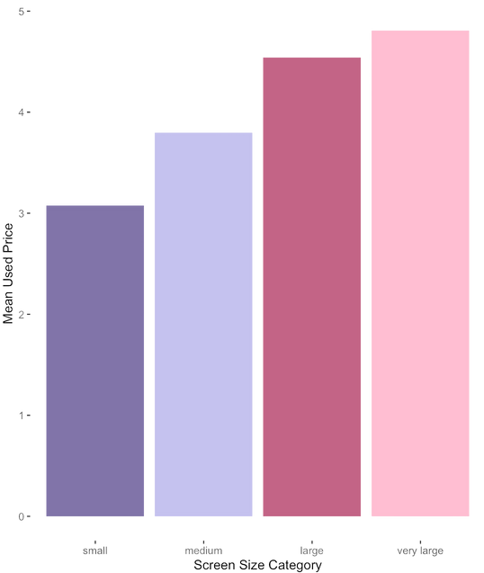
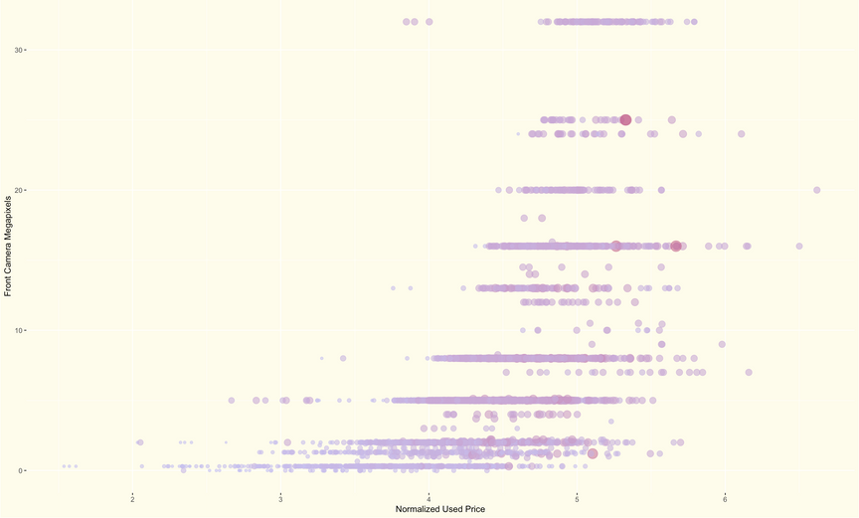
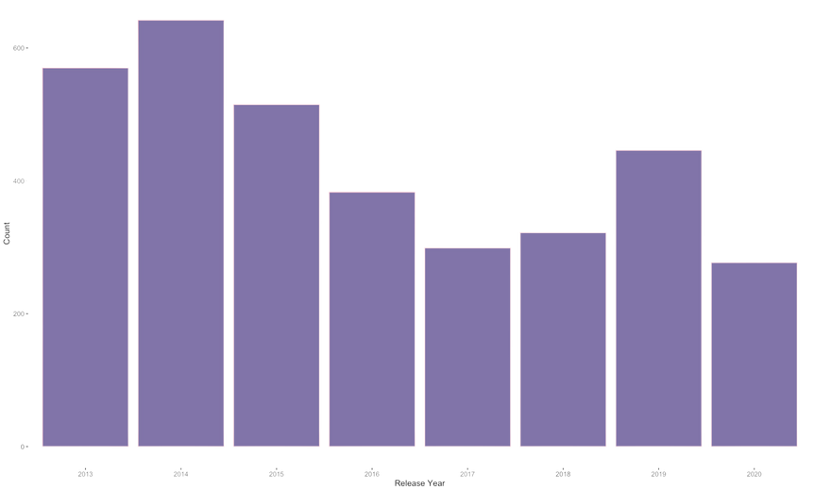
DATA INSIGHTS
used price vs new price
used price vs release year
device count by brand
used price vs screen size
device count by release years
used price vs front and rear camera

Slide 4




DATA-DRIVEN MODELING
Segmentation of devices using
Logistic Regression classifier
Predicting resale value employing
Multiple Linear Regression
Premium
Wallet-Friendly

Slide 5

RECOMMENDATIONS
Utilize the classification model to optimize inventory mix, balancing premium and wallet-friendly devices to maximize turnover and profit margins.
Leverage classification to implement optimized pricing strategies.
Offer Extended Warranty Options for refurbished devices to enhance their resale value and generate additional revenue.
Focus on acquiring devices with Higher New Prices, High-Quality Camera Resolutions, Larger screens and RAM which tends to fetch better resale prices, contributing to higher profitability.

Slide 6

FUTURE SCOPE
Enhanced Customer Segmentation: Utilizing customer demographics data, we will employ localized segmentation strategies to better understand and target distinct customer groups.
Personalized Affordability Analysis: By analyzing customer income and budget data, we aim to tailor device recommendations that align with individual affordability thresholds.
Dynamic Recommendations: Leveraging customer transactional data, we will provide personalized device recommendations based on browsing behavior.
Explore diversification opportunities beyond mobile phones and tablets, such as laptops, smartwatches, and accessories.

Slide 7

ReNew
MOBILE COMPANY
THANK YOU
Lavanya Govindarajan

